Slide 1
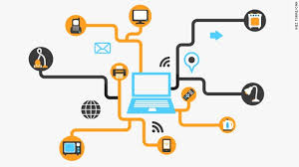
Generic IOT Platform
Team 1

Slide 2
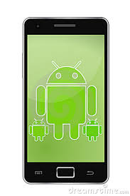


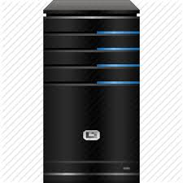
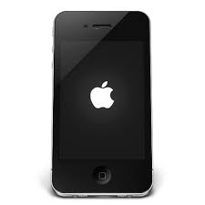
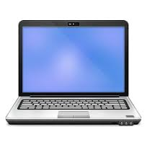
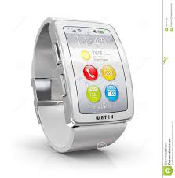
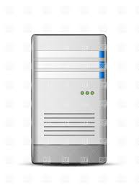

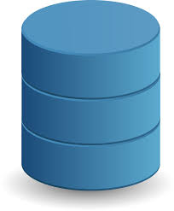
gateway
Filter server
Logical server
sensor
R-R-S server
User app
DB
admin

Slide 3

Sensors & Gateway

Slide 4
Configuring Sensors and Gateways
New sensors are configured by adding sensor id, sensor name, gateway id, sensor type, sensor location(coordinates), location name, protocol type and SI unit. This can be registered in two ways:- through repository.xml or UI.
New gateways are configured by adding gateway id(MAC Address), gateway location name, gateway location(coordinates). This can be registered in two ways:- through repository.xml or UI.

Slide 5
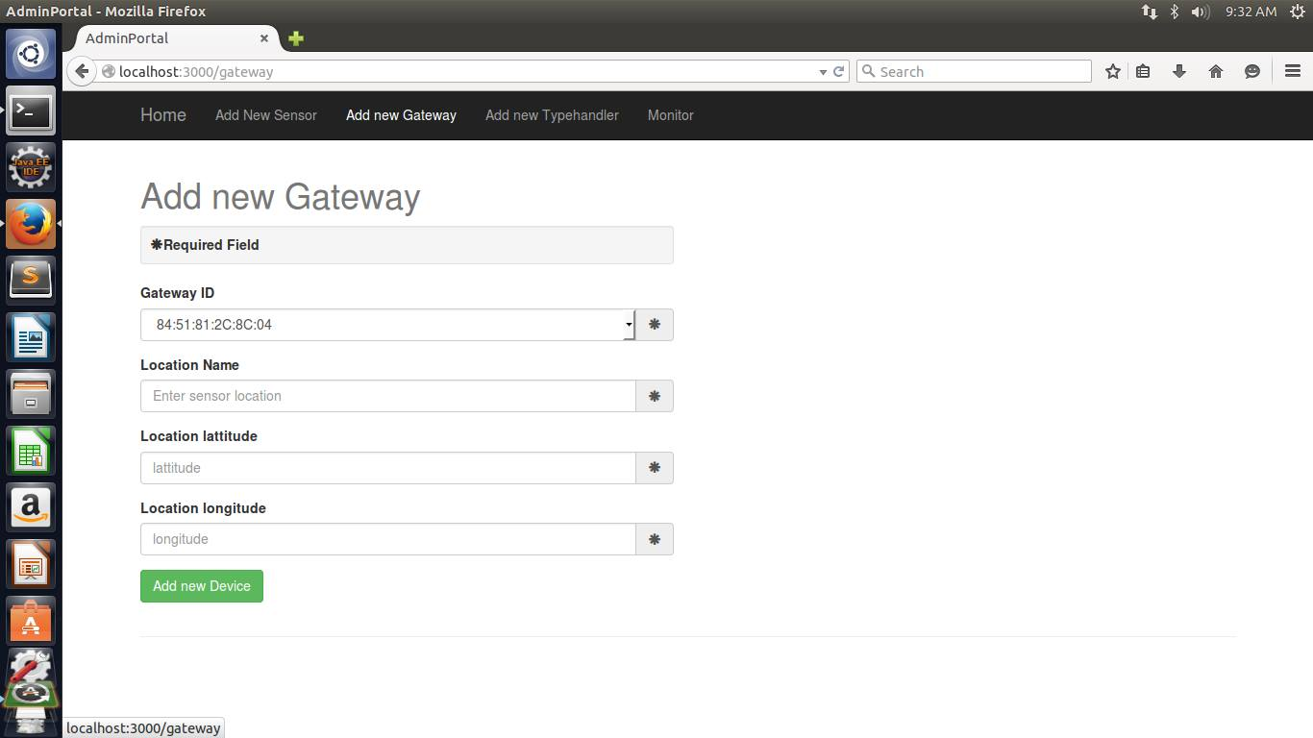

Slide 6
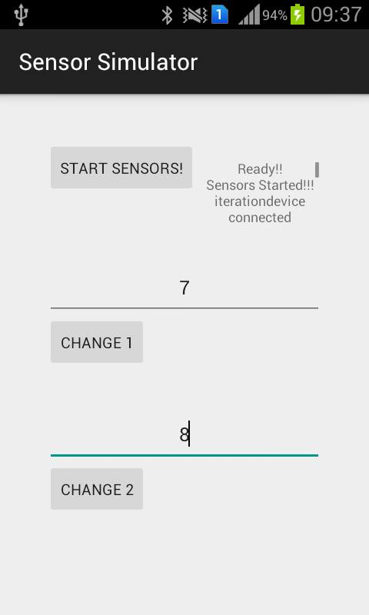
Sensor Simulation
Multiple sensors are simulated using a single android device.

Slide 7
Gateway
When the gateway is powered on, it fetches the list of sensors from the repository server.
Gateway is authenticated by its MAC address.
Then, gateway starts to poll data from connected sensors with frequency of 5 seconds.
Registry server pings gateways to get the status of connected sensors in every 3 seconds. Through this it can also get the status of gateway.
Filter server requests for data from the gateways in every 3 seconds.

Slide 8
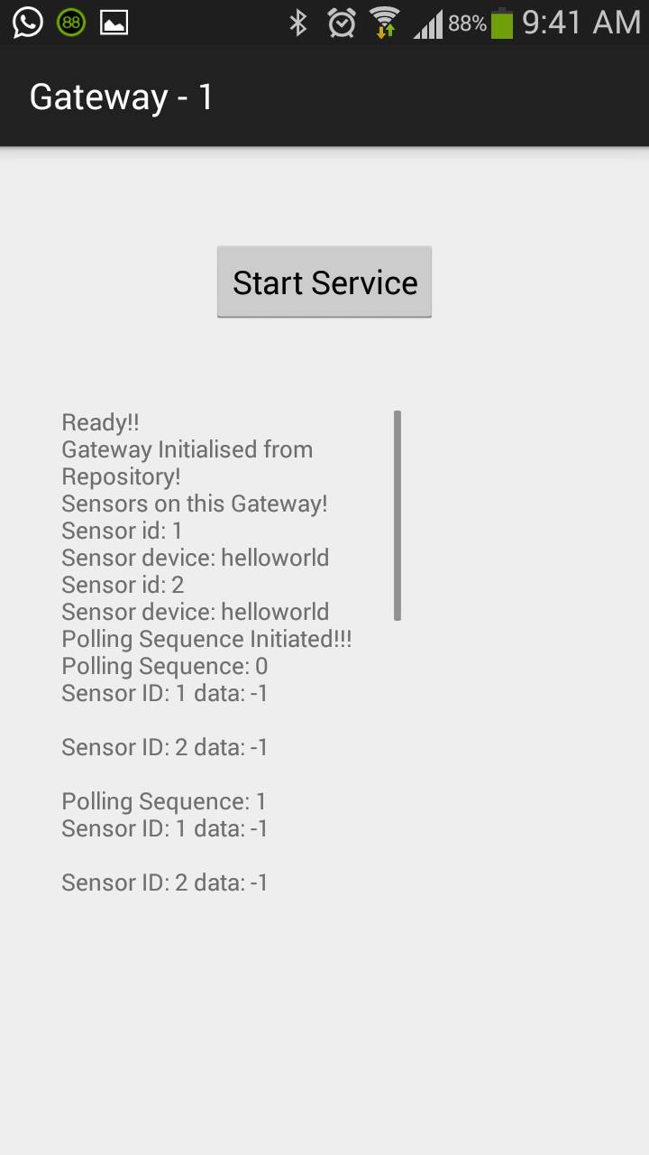
Gateway

Slide 9
JSON Object format
{
sensorID: <value>
gatewayID: <MAC Address>
deviceName: <value>
type: <sensor_type>
unit: <SI_unit>
location: <location_name>
data: <value>
geo: [ longitude, latitude ]
}

Slide 10


Filter Server, Registry and Repository Server

Slide 11
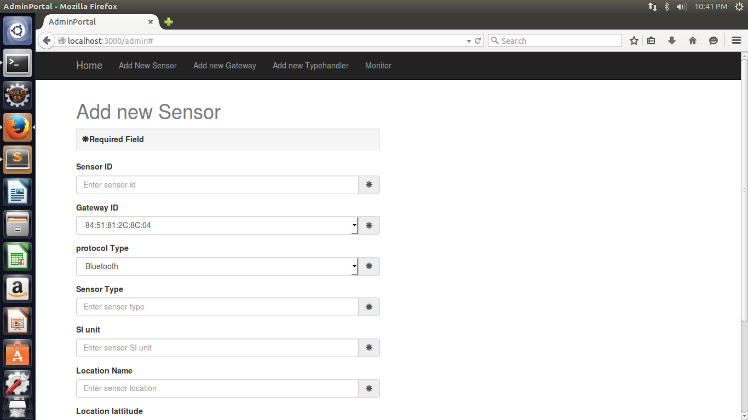
Admin User Interface

Slide 12
Repository xml
<repository>
<gateway id=”1”>
<hwid>...</hwid>
<location> …. </location>
<sensor id=”s1”>
<hwid>…</hwid>
<type>Motion</type>
<geolocation>...</geolocation>
<location>...</location>
</sensor>
</gateway>
</repository>

Slide 13
Registry Server
Activity Status
Monitor status of filter server, gateways and sensors
Sensor Information
Gateways and associated sensors
APIs for locating sensors
Geo-location
2. Text location
3. Altitude

Slide 14
Filter Server
REST API
Command API.
Location API
Callback API
Continuous data API
Sensory data
Handles continuous stream of sensor data from gateways

Slide 15
Logic Server
Node server
Collaborates user application and filter server
Invokes REST APIs exposed by filter server and gateways
Responsible for delivering callback results to application
Implements application-specific APIs

Slide 16


Logic Server & Application

Slide 17
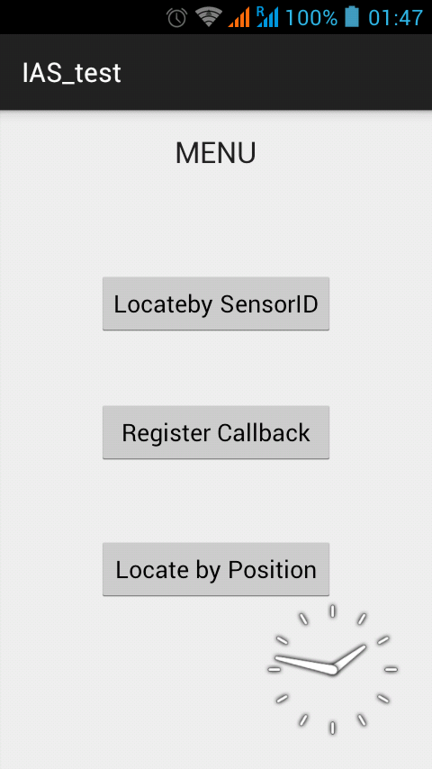
USE CASE: TEMPERATURE ALERT NOTIFIER
The End user is provided the following functionalities:
Get data by Sensor ID.
Get data by Position.
Register for Callback Functionality.

Slide 18
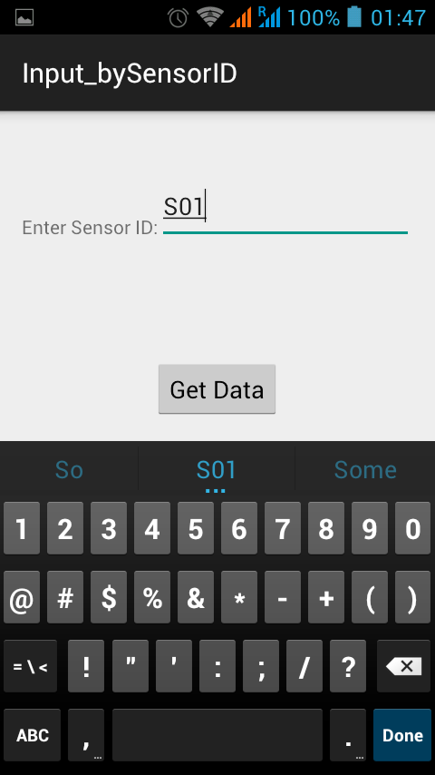
Get Data by Sensor ID
User application sends request through GETDATA API of the logic server which returns the data in JSON format in the response.
GetData API:
Request Format: SensorID
JSON Response Format: {SensorID, Data, GeoLocation, Location, Unit, Type}

Slide 19
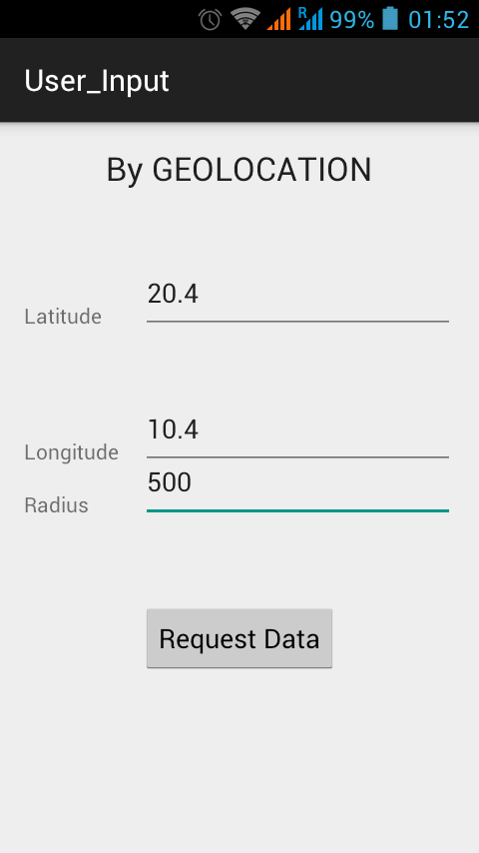
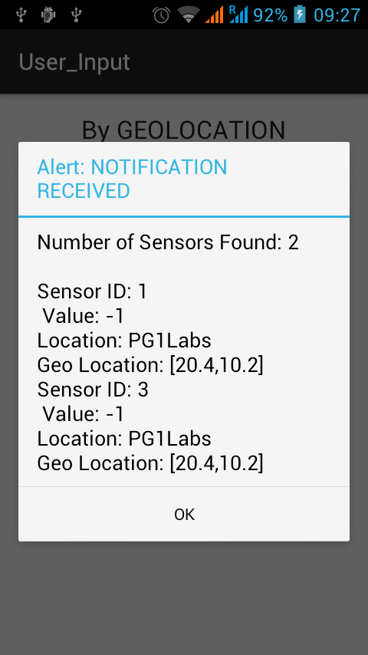
Get Data by GeoLocation
The data is sent to Logical Server through geolocation API which returns the data obtained from all sensors in that particular radius from the specified location.

Slide 20
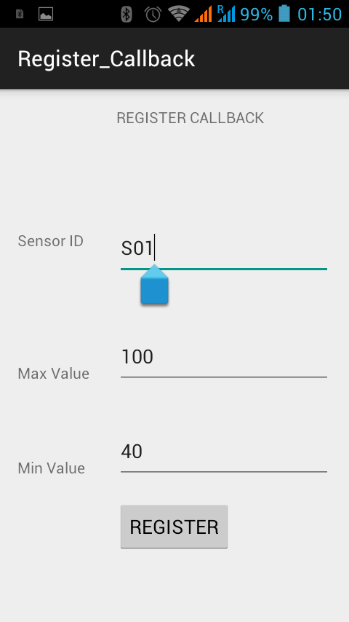
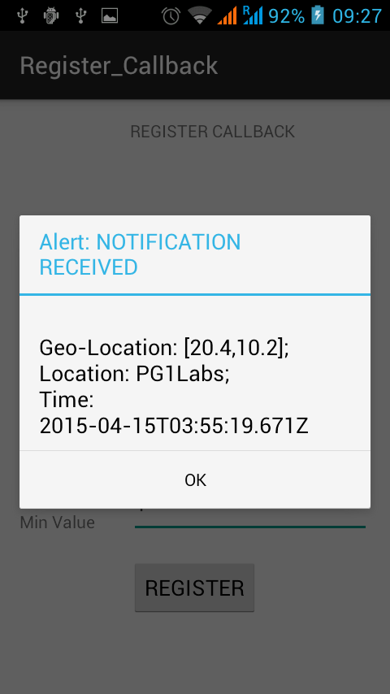
Register For CallBack Functionality
User is provided the functionality to register for a constant ‘checker’ which keeps an eye over the data obtained from the specified sensor and notifies the user if the data falls out of the specified threshold.

Slide 21
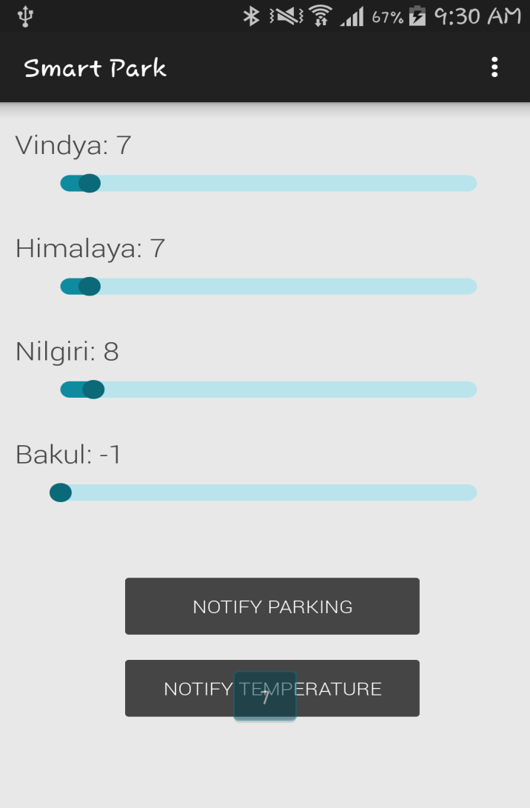
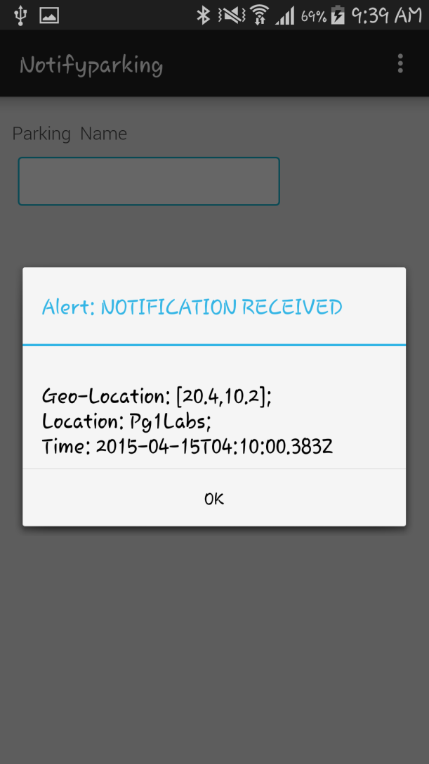
USE CASE- Get Parking Status
This Notify us about the parking status of each building

